Slide 1

Online Aeroplane BOOKING system
Raghuraj Pratap Singh----23SCSE1180562
Mukund rai---
Atul Kumar Dubey----
Prakhar Pratap Singh-----
This Photo by Unknown Author is licensed under CC BY-SA

Slide 2
How to Book an Airplane Ticket Online?
Choose a Booking Platform
Start by selecting a platform to book your flight. You have two main options:
Airline Websites: Visit the official website of the airline you prefer, like American Airlines, Delta, Air india or Emirates.
Travel Booking Websites: Use third-party travel platforms like Expedia, Kayak, or Google Flights to compare prices across airlines and find the best deals.

Slide 3
Enter Your Travel Information
Once on your chosen website or app, enter your travel details:
Departure and Destination Airports: Select your starting airport and your destination.
Travel Dates: Pick your departure date and, if booking a round trip, your return date.
Number of Passengers: Choose the number of travelers and specify adults, children, or infants.
Class Preference (Optional): If available, choose a cabin class (Economy, Premium Economy, Business, First Clas

Slide 4
Browse and Select a Flight
The site will show you various flight options based on your search. Here’s what to consider:
Price: Check if the price fits your budget.
Flight Duration: Direct flights are faster but may cost more.
Layovers: If there are layovers, note the location and duration. Some prefer direct flights, while others are fine with layovers for a lower fare.
Departure and Arrival Times: Choose timings that fit your schedule.

Slide 5
challenges
Issues in Existing Booking Systems
Long Queues and Waiting Times
Traditional booking methods require users to wait in physical lines or deal with time-consuming processes.
Limited Accessibility and Outdated Interfaces
Many existing systems are not mobile-friendly or user-friendly, making navigation cumbersome.
Lack of Real-Time Updates
Information on seat availability and pricing is often outdated, leading to booking errors or delays.
Security Concerns in Payment and Data Management
Insufficient protection of sensitive user data can lead to fraud and unauthorized access.

Slide 6
Our goal
Simplify the flight booking process with an intuitive interface.
Provide secure and seamless payment options.
Offer real-time updates on flight availability and pricing.
Enable users to manage bookings and cancellations easily.
Include an admin panel for managing flight details.

Slide 7
A system flow
A diagram showing:User Interaction: Search flights, book tickets, make payments.
Backend Processes: APIs, payment gateway, and database.
Database Layers: Storing user, flight, and booking details

Slide 8
Key feature
Flight Search and Filter: Search flights by destination, date, airline, etc.
Seat Availability: Real-time updates on available seats.
Booking and Payment: Secure payment integration with receipt generation.
User Account Management: Login, registration, and booking history.
Admin Panel: Manage flight schedules, pricing, and user bookings.

Slide 9
TECH STACK HTML PAGE
<!DOCTYPE html>
<html lang="en">
<head>
<meta charset="UTF-8">
<meta name="viewport" content="width=device-width, initial-scale=1.0">
<title>Airplane Booking</title>
<style>
body {
font-family: Arial, sans-serif;
margin: 0;
background: #f4f4f9;
}
.container {
max-width: 600px;
margin: 50px auto;
padding: 20px;
background: #fff;
text-align: center;
border-radius: 8px;
box-shadow: 0 4px 10px rgba(0, 0, 0, 0.1);
}
h1 {

Slide 10
HTML CODE
font-size: 24px;
color: #333;
}
input, select, button {
width: 100%;
margin: 10px 0;
padding: 10px;
font-size: 16px;
border: 1px solid #ccc;
border-radius: 5px;
}
button {
background: #007bff;
color: white;
border: none;
cursor: pointer;
}
button:hover {
background: #0056b3;
}
.hidden {
display: none;

Slide 11
HTML CODE
}
</style>
</head>
<body>
<div class="container">
<h1>Airplane Booking</h1>
<div id="login-section">
<h2>Login</h2>
<input id="email" type="email" placeholder="Email">
<input id="password" type="password" placeholder="Password">
<button onclick="login()">Login</button>
</div>
<div id="booking-section" class="hidden">
<h2>Book a Flight</h2>
<input id="destination" type="text" placeholder="Destination">
<input id="date" type="date">
<select id="class">
<option value="economy">Economy</option>
<option value="business">Business</option>
<option value="first">First Class</option>
</select>
<h3>Payment Details</h3>

Slide 12
HTML CODE
<input id="card-name" type="text" placeholder="Card Name">
<input id="card-number" type="text" placeholder="Card Number">
<input id="expiry" type="text" placeholder="Expiry (MM/YY)">
<input id="cvv" type="text" placeholder="CVV">
<button onclick="book()">Book & Pay</button>
</div>
</div>
<script>
const validUser = { email: “raghuraj@234.com", password: "password123" };
function login() {
const email = document.getElementById("email").value;
const password = document.getElementById("password").value;
if (email === validUser.email && password === validUser.password) {
alert("Login Successful!");
document.getElementById("login-section").classList.add("hidden");
document.getElementById("booking-section").classList.remove("hidden");
} else {
alert("Invalid Credentials");
}
}
function book() {

Slide 13
HTML CODE
const destination = document.getElementById("destination").value;
const date = document.getElementById("date").value;
const flightClass = document.getElementById("class").value;
const cardName = document.getElementById("card-name").value;
const cardNumber = document.getElementById("card-number").value;
const expiry = document.getElementById("expiry").value;
const cvv = document.getElementById("cvv").value;
if (destination && date && flightClass && cardName && cardNumber && expiry && cvv) {
alert(`Flight booked successfully!\nDestination: ${destination}\nDate: ${date}\nClass: ${flightClass}\nPayment by: ${cardName}`);
} else {
alert("Please fill all fields.");
}
}
</script>
</body>
</html>

Slide 14
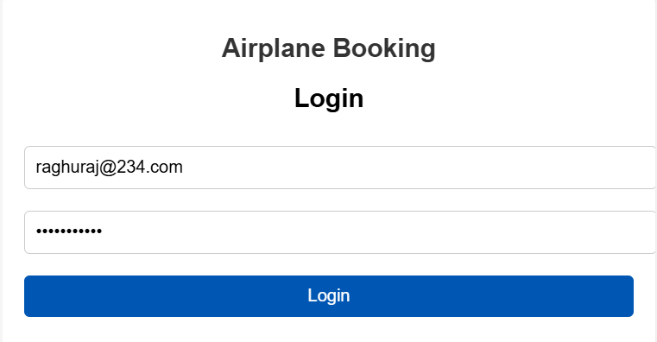
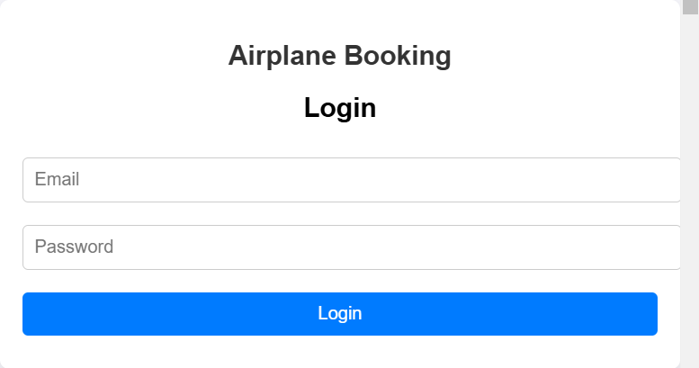
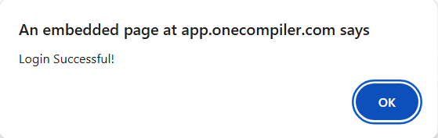
OUTPUT

Slide 15
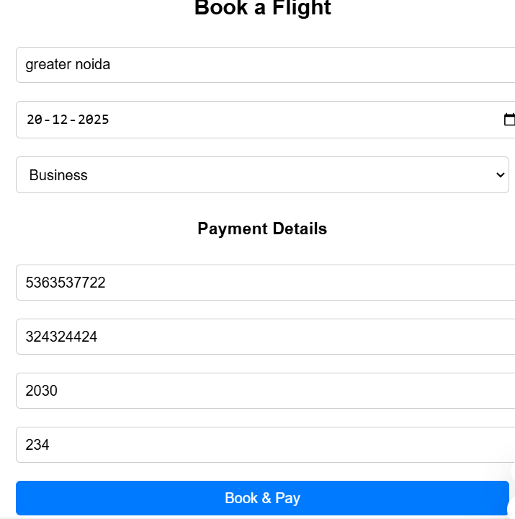
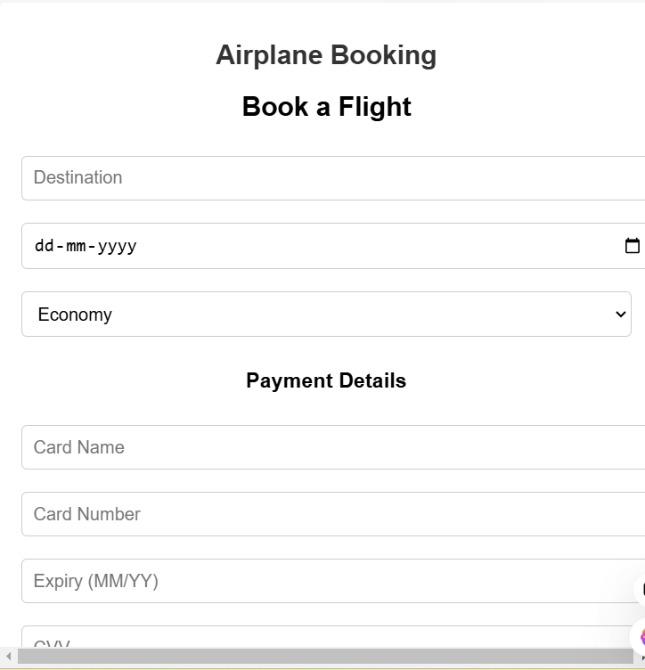
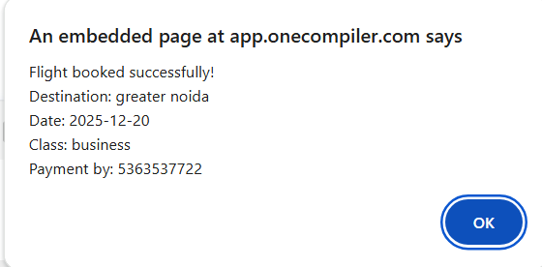
OUTPUT

Slide 16
JAVA CODE FOR FLIGHT BOOING
import java.util.*;
class Flight {
private String flightNumber;
private String source;
private String destination;
private double price;
private int availableSeats;
public Flight(String flightNumber, String source, String destination, double price, int availableSeats) {
this.flightNumber = flightNumber;
this.source = source;
this.destination = destination;
this.price = price;
this.availableSeats = availableSeats;
}
public String getFlightNumber() {
return flightNumber;
}
public String getSource() {
return source;

Slide 17
JAVA CODE
}
public String getDestination() {
return destination;
}
public double getPrice() {
return price;
}
public int getAvailableSeats() {
return availableSeats;
}
public boolean bookSeat() {
if (availableSeats > 0) {
availableSeats--;
return true;
} else {
return false;
}
}

Slide 18
JAVA CODE
}
class Booking {
private String customerName;
private Flight flight;
private int numberOfSeats;
public Booking(String customerName, Flight flight, int numberOfSeats) {
this.customerName = customerName;
this.flight = flight;
this.numberOfSeats = numberOfSeats;
}
public void displayBookingDetails() {
System.out.println("Booking Confirmation:");
System.out.println("Customer Name: " + customerName);
System.out.println("Flight Number: " + flight.getFlightNumber());
System.out.println("From: " + flight.getSource());
System.out.println("To: " + flight.getDestination());
System.out.println("Seats Booked: " + numberOfSeats);
System.out.println("Total Price: " + (numberOfSeats * flight.getPrice()));
}

Slide 19
JAVA CODE
}
public class Main {
private static List<Flight> flights = new ArrayList<>();
private static Scanner scanner = new Scanner(System.in);
public static void main(String[] args) {
// Sample Flights
flights.add(new Flight("AI101", "New York", "London", 500.0, 50));
flights.add(new Flight("AI102", "London", "Paris", 300.0, 60));
flights.add(new Flight("AI103", "Paris", "Tokyo", 800.0, 40));
while (true) {
System.out.println("\nAirplane Booking System");
System.out.println("1. View Available Flights");
System.out.println("2. Book a Flight");
System.out.println("3. Exit");
System.out.print("Enter choice: ");
int choice = scanner.nextInt();
scanner.nextLine(); // Consume newline
switch (choice) {

Slide 20
JAVA CODE
case 1:
viewAvailableFlights();
break;
case 2:
bookAFlight();
break;
case 3:
System.out.println("Exiting system...");
return;
default:
System.out.println("Invalid choice, please try again.");
}
}
}
public static void viewAvailableFlights() {
System.out.println("\nAvailable Flights:");
for (Flight flight : flights) {
System.out.println("Flight Number: " + flight.getFlightNumber());
System.out.println("From: " + flight.getSource());
System.out.println("To: " + flight.getDestination());
System.out.println("Price: " + flight.getPrice());

Slide 21
JAVA CODE
System.out.println("Available Seats: " + flight.getAvailableSeats());
System.out.println("---------------------------");
}
}
public static void bookAFlight() {
System.out.print("Enter Customer Name: ");
String customerName = scanner.nextLine();
System.out.print("Enter Flight Number to book: ");
String flightNumber = scanner.nextLine();
Flight selectedFlight = null;
for (Flight flight : flights) {
if (flight.getFlightNumber().equals(flightNumber)) {
selectedFlight = flight;
break;
}
}
if (selectedFlight != null && selectedFlight.getAvailableSeats() > 0) {
System.out.print("Enter number of seats to book: ");

Slide 22
JAVA CODE
int seatsToBook = scanner.nextInt();
if (seatsToBook <= selectedFlight.getAvailableSeats()) {
selectedFlight.bookSeat();
Booking booking = new Booking(customerName, selectedFlight, seatsToBook);
booking.displayBookingDetails();
} else {
System.out.println("Not enough seats available.");
}
} else {
System.out.println("Flight not found or no available seats.");
}
}
}

Slide 23
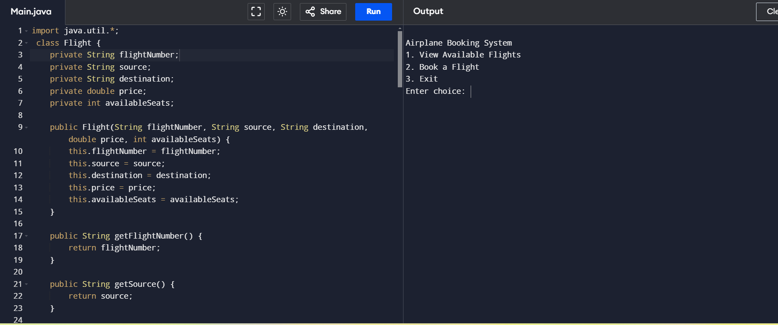
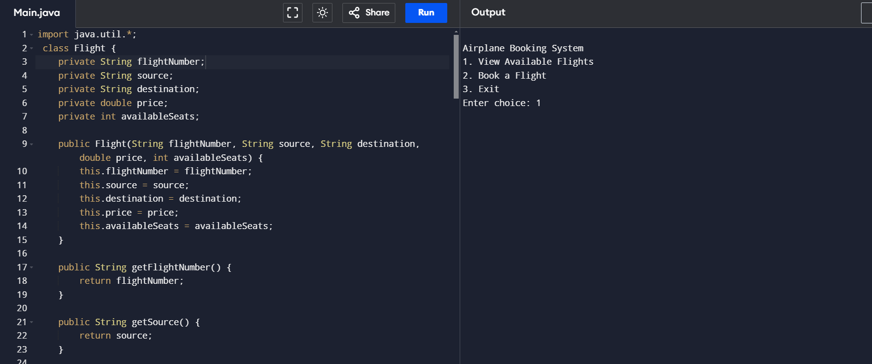
OUTPUT

Slide 24
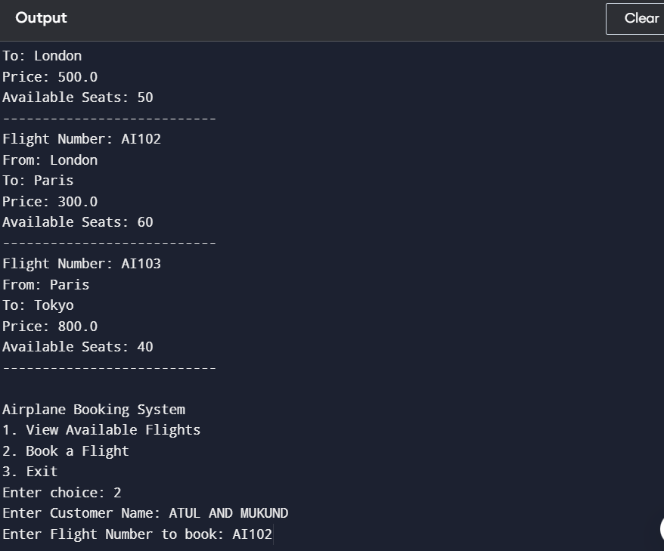
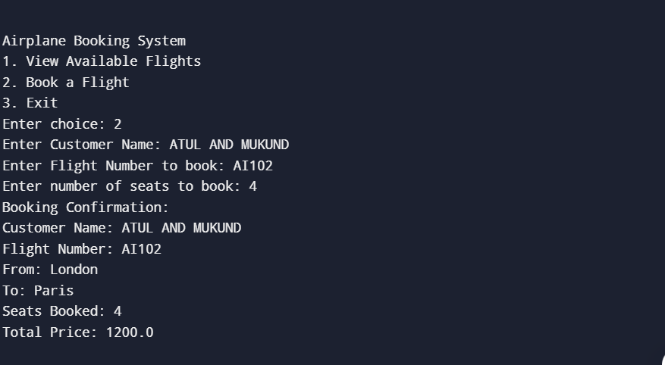
OUTPUT

Slide 25
DATABASE OF PROJECT user database
1. Users Table
Stores information about customers and administrators.
Field Name | Data Type | Description
user_id | INT | Unique identifier for the user (Primary Key)
first_name | VARCHAR | Customer's first name
last_name | VARCHAR | Customer's last name
email | VARCHAR | User's email address
password | VARCHAR | User's password (hashed)
phone_number | VARCHAR | User's phone number
role | VARCHAR | Role of the user (admin, customer)

Slide 26
DATABASE
2. Flights Table
Stores information about available flights.
Field Name | Data Type | Description
flight_id | INT | Unique identifier for the flight (Primary Key)
flight_number | VARCHAR | Flight number (e.g., AA123)
airline | VARCHAR | Airline name
departure_city | VARCHAR | Departure city
arrival_city | VARCHAR | Arrival city
departure_time | DATETIME | Flight departure time
arrival_time | DATETIME | Flight arrival time
seats_available | INT | Number of available seats
Field Name | Data Type | Description
payment_id | INT | Unique identifier for the payment (Primary Key)
booking_id | INT | Associated booking ID (Foreign Key)
payment_date | DATETIME | Payment date
payment_method | VARCHAR | Payment method (Credit card, PayPal, etc.)
amount_paid | DECIMAL | Amount paid for the booking
payment_status | VARCHAR | Status of the payment (paid, pending)

Slide 27
DATABASE
5. Airports Table
Stores details about airports.
Field Name | Data Type | Description
seat_id | INT | Unique identifier for the seat (Primary Key)
flight_id | INT | Flight ID the seat is associated with (Foreign Key)
seat_number | VARCHAR | Seat number (e.g., 1A, 12B)
seat_class | VARCHAR | Seat class (Economy, Business, First)
is_reserved | BOOLEAN | Indicates if the seat is reserved
Field Name | Data Type | Description
airport_id | INT | Unique identifier for the airport (Primary Key)
airport_name | VARCHAR | Name of the airport
city | VARCHAR | City where the airport is located
country | VARCHAR | Country where the airport is located

Slide 28
What We Faced & How We Solved It
Challenges:
Handling large datasets for real-time seat availability.
Ensuring payment security and PCI compliance.
Designing an intuitive and responsive UI.
Solutions:
Optimized database queries and indexing.
Integrated industry-standard payment APIs.
Conducted user testing for UI improvements.

Slide 29
conclusion
Summarize the project’s value to users and administrators.
Highlight the alignment of the system with project goals.
Emphasize how the project addresses real-world challenges.

